Slide 1
FUNDAMENTALS OF TOOTH PREPARATION
Dr. Rhythm

Slide 2
Primary retention form is the shape or form of the conventional preparation that resists displacement or removal of the restoration by tipping or lifting forces.
For amalgam Class I and II preparations , the material is retained in the tooth by developing external tooth walls that converge occlusally.

Slide 3
Composites restorations primarily are retained in the tooth by a micromechanical bond that develops between the material and etched and primed prepared tooth structure.
Cast metal (usually a gold alloy) intracoronal restorations rely primarily on almost parallel walls to provide retention.
A small degree of divergence (2-5 degrees per wall ) from the line of draw that would enhance retention form.

Slide 4
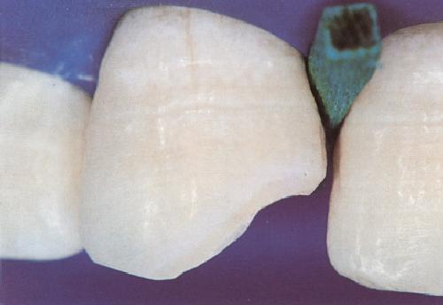
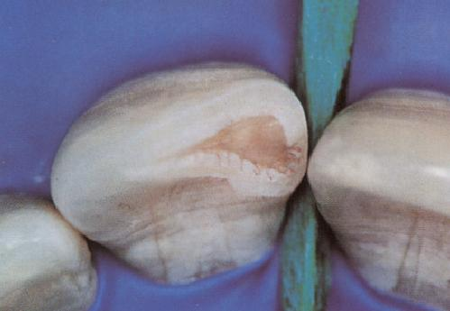
Obtain retention form with bonding
Acid etched enamel
With frosty appearance
etched enamel/Dentin slightly glossy, not dehydrated
Notes:
Read slide.

Slide 5
The greater the vertical height of the walls, the more divergence is permitted.
Close parallelism of prepared walls is a principal retention for cast metal restoration, other being the use of luting agent that bonds to the tooth structure.
In class II preparations an occlusal dovetail may aid in preventing the tipping of the restoration by occlusal forces.

Slide 6
Additional Factors for retention form
(1)Frictional retention.
(a)surface area of contact between wall and restorative material.
(b)opposing walls involved.
(c )parallelism of walls
(d)proximity of material and tooth structure.

Slide 7
Frictional retention

Slide 8
Changing the position of dentinal walls and floors microscopically by using condensation energy within the dentin’s proportional limit can add more gripping action by the tooth on restorative material.
This occurs when to dentin regains its original position while the restorative material rigid, thereby completely obliterating any remaining space in the cavity preparation.

Slide 9
Elastic deformation of dentin.

Slide 10
Convenience form
Shape or form of preparation that provides for adequate observation,accessability and ease of preparation.
In gold foil filling convenience form also serves as retention form.
Occlucsal divergence in cast restoration.
Instrument modification for convenience form.
Seperation of teeth.

Slide 11
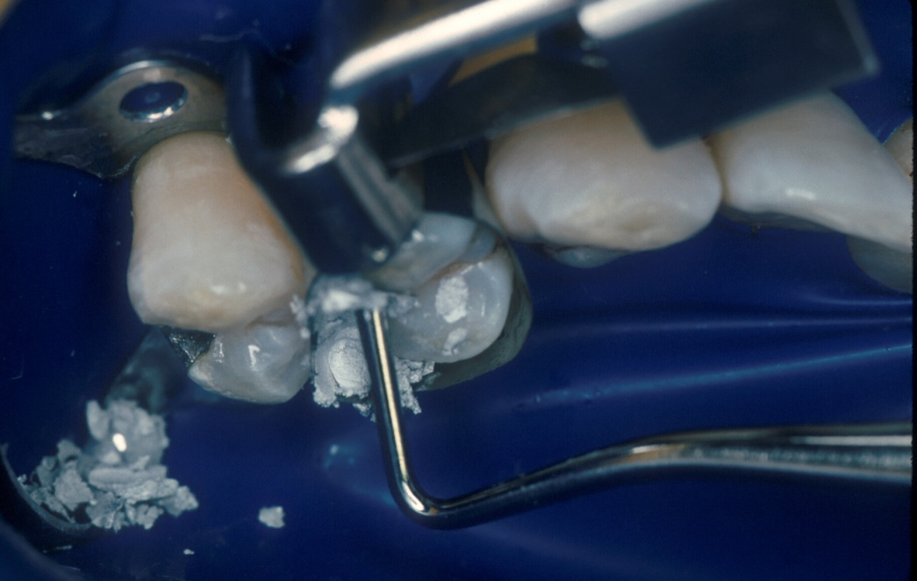
Obtain convenience form
To place the amalgam restoration the instrument (amalgam condenser) for pushing the amalgam into the tooth must fit into the preparation (convenience form)

Slide 12
Removal of any remaining pit or fissure, infected dentin, material
Any old material should be removed if(a)old material may effect negatively the aesthetics.
(b)old material may compromise retention.(GIC under composite)
(c)Radiographic evidence of caries under restoration.
(d)Tooth symptomatic preoperatively.
(e) periphary of old material not intact.

Slide 13
Caries disclosing dyes may help in differentiating affected and infected dentin.
Leaving residual caries at DEJ area is totally unacceptable.
Removal of caries is indicated early in preparation when
(a)in large preparations with extensive soft caries,as remaining structure will determine the material to be used.
(b)Caries control technique-when patient has numerous teeth with extensive caries.

Slide 14
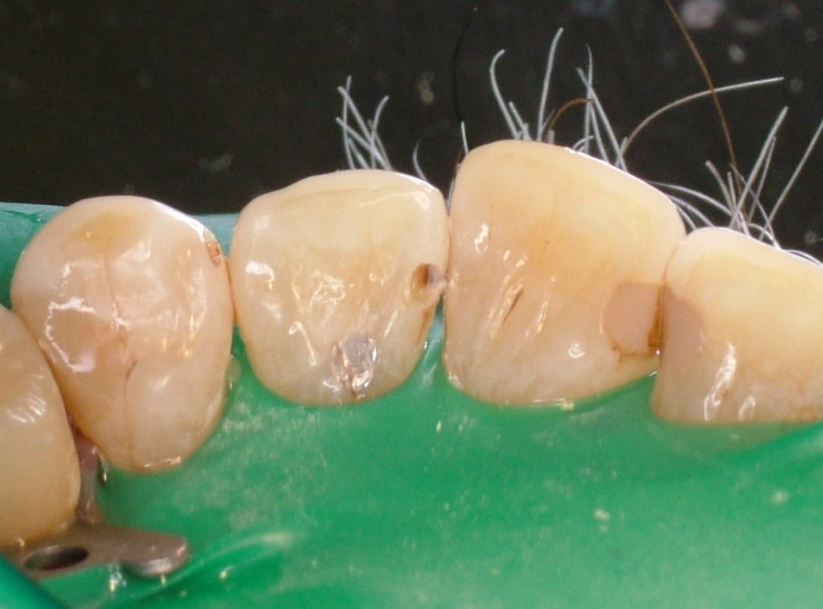
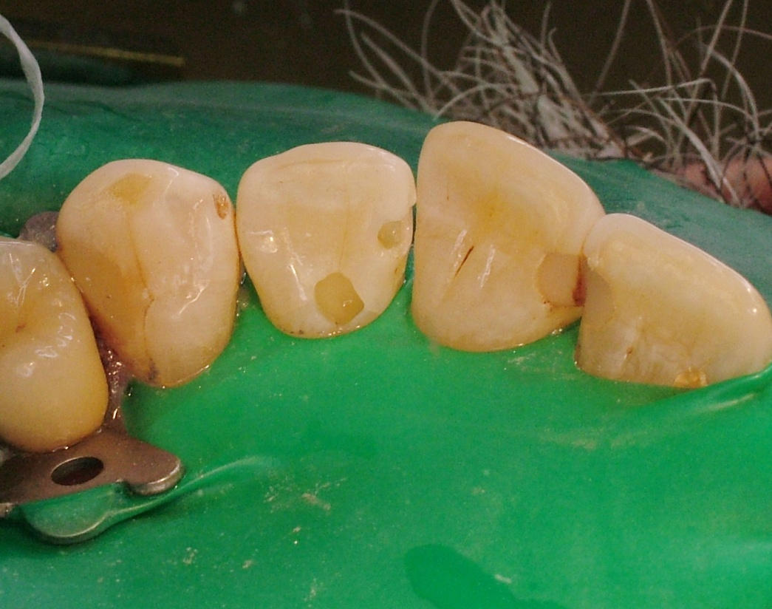
Removing remaining carious dentin
Caries removed
From Class 3
Restoration on lingual
will also be replaced

Slide 15
Technique of removing remaining carious dentin:
When pulpal or axial wall has been established at the proper initial tooth preparation, and a small amount of infected dentin remains, only this material should be removed, leaving a rounded concave area in the wall. The wall peripheral to the caries removal depression should not be altered.

Slide 16
Large areas of soft caries are usually are best removed with spoon excavators by flaking up the caries around the periphery of the infected mass and peeling it off in layers.
The harder, heavily discoloured dentin should be removed by round stell burs rotating at high speed and round carbide burs rotating at high speed.

Slide 17
Pulp damage may result from creation of frictional heat with bur, and excessive pressure from the excavator may force bacteria into the dentinal tubules.
Ideal method should use least pressure and frictional heat.
Round carbide bur at high speed with air coolant .

Slide 18
Secondary resistance and retention forms
The secondary resistance and retention forms are of two types:
A). Mechanical preparation
B). Treatments of preparation walls with etching

Slide 19
Mechanical features:
Retention locks, grooves, coves: Vertically oriented retention locks and retention grooves are used

Slide 20
Q.1 What factor is important for primary retention
a. Sufficient depth
b. Sufficient width
c. Converging walls
D. sufficient bulk

Slide 21
Q.2 Amalgam is
A. Elastic in nature
B. Brittle in nature
C. Adhesive in nature
D. Resilient

Slide 22
Q.3 Ideal burs used for amalgam preparation is
A. No. 245
B. No. 234
C. No. 265
D. No. 256

Slide 23
Q. 4 Dove tail provides
A. Primary retention form
B. Primary resistance form
C. Secondary retention
D. Secondary resistance

Slide 24
Q. 5 Bulk provides
A. Fracture resistance
B. retention
C. Secondary retention
D. Secondary resistance.

